Slide 1

RISK PREDICTION OF STROKE FROM THE RISK FACTORS USING DATA MINING TECHNIQUES
Masum Mohammad Jubayel
ID: 151-115-105
Asima Akter Chowdhury
ID: 151-115-082
Supervisor
Rahatara Ferdousi
Lecturer
Department of CSE
Metropolitan University

Slide 2
Paper Content
Page:1
Introduction
Related work
Objectives & Contribution
Dataset details table
Questionnaire form of risk prediction of Stroke
Flow chart of Methodology
System Architecture
Result
Code implement Using Python
Decision Tree
Used Equations for Decision Tree
Manual Analysis of the Dataset using 10 samples
Proposed Tool
Demo of predicted result Stroke
Demo of predicted result Non-stroke
Challenges
Limitation
Conclusion & Future Scope
References

Slide 3
Introduction
Page: 2
What is Stroke ?
A stroke occurs if the flow of oxygen-rich blood to a portion of the brain is blocked [1]
Data mining for risk prediction model: Data mining classification techniques like- NB, SVM, ANN, J48, RF, RT, LG are using for reliable risk prediction of disease due to having the capability of finding hidden of relevant data.
Role of risk factor of stroke for prediction:
The more risk factor a patient has, the more chances to have a stroke [2]
Risk factor can be controlled [3]

Slide 4
Related work
Page: 3
Paper Name | Author Name | Dataset information | Used data mining techniques | Obtained accuracy
STROKE RISK PREDICTION THROUGH NONLINEAR SUPPORT VECTOR CLASSIFICATIONS MODELS | Sabibullah Mohammaed Hanifa and Kasmir Raja S.V | 100 data with 8 attributes | Confusion matrix (RBF and polynomial) | 98%, 92%
PREDICTION OF STROKE USING DATA MINING CLASSIFICATION OF STROKE | Ohoud Almadami and Riyad Alshammari | 969 data | C4.5, Jrip and multilayers perceptron | 92.60%, 95.25%
ASSESSMENT OF STROKE RISK BASED ON MORPHOLOGICAL ULTRASOUND IMAGE ANALYSIS WITH CONFORMAL PREDICTION | Antonis Lambrou, Harris Papadopoulos | 6 features | ANN, NB, SVM, and K-NN | 98%
A MODEL FOR PREDICTING ISCHEMIC STROKE USING DATA MINING ALGORITHMS | Balar Khalid and Naji Abdelwahab | 265 data | C4.5 DT algorithm and Logistic regression | 77.58% , 83.03%

Slide 5
Objectives & Contribution
Page: 4
To prepare an Appropriate dataset of Risk Factors
To use the most popular risk prediction data mining algorithm for the dataset
To obtain the best algorithm
To design an end-user tool (website)
for mass people with the
*checking feature developed with the best algorithm.

Slide 6
Dataset details table
Page: 5
Description of attribute
Attributes | Values
Age | 1.25-34, 2.35-44, 3.45-54,4.55-65,5.65<
Gender | 1. Male 2. Female
Systolic BP | 1.120>, 2.120-139, 3. 140-160, 4.160<
Diastolic BP | 1.80>, 2.80-95, 3.95<
Diabetes | 1. No, 2. Yes
Ischemic Heart Disease | 1. No, 2. Yes
Family History of stroke | 1. No, 2. Yes
Alcoholism | 1. No, 2. Yes
Less Physically Active | 1. No, 2. Yes
Smoking | 1. No, 2. Yes
Stress and depression | 1. No, 2. Yes
Saturated Fat↑ () | 1. No, 2. Yes
Fibre↓ () | 1. No, 2. Yes
Chronic Kidney Disease (CKD) | 1. No, 2. Yes
Class Attribute | 1. Stroke, 2. Non-stroke
Description of the training dataset
 | Number of Attributes | Number of Instances
Report based dataset | 15 | 435

Slide 7
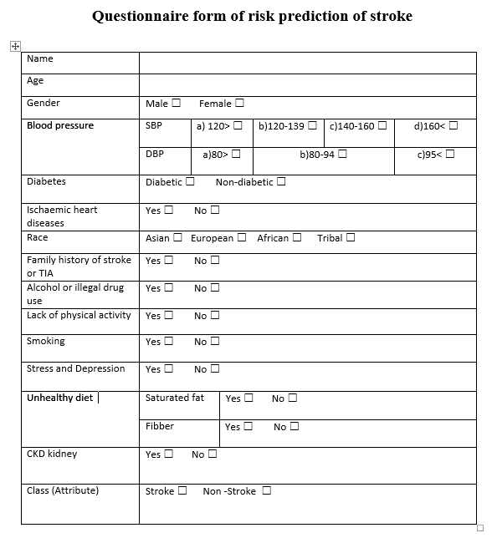
Questionnaire form of Risk Prediction of Stroke
Page: 6
Fig. 1. Questionnaire form

Slide 8
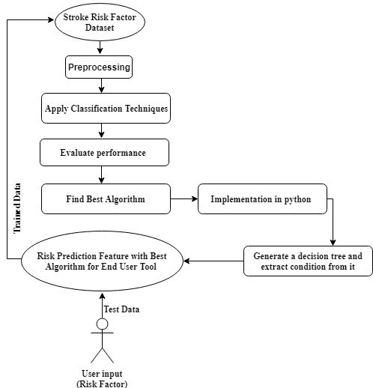
Flow Chart of Methodology
Page: 7
Fig. 2. Flow chart of Methodology

Slide 9
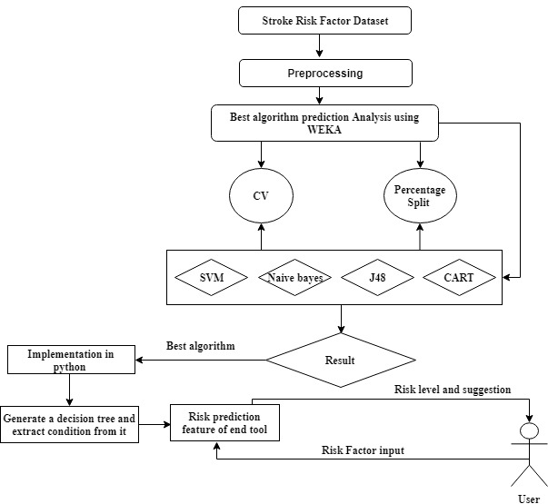
System Architecture
Page: 8
Fig. 3. Proposed System architecture

Slide 10
Result
Page: 9
The results are retrieved using the data mining tool Weka (3.8) and evaluated with 10-fold Cross validation and Percentage Split method.
Accuracy table

Slide 11
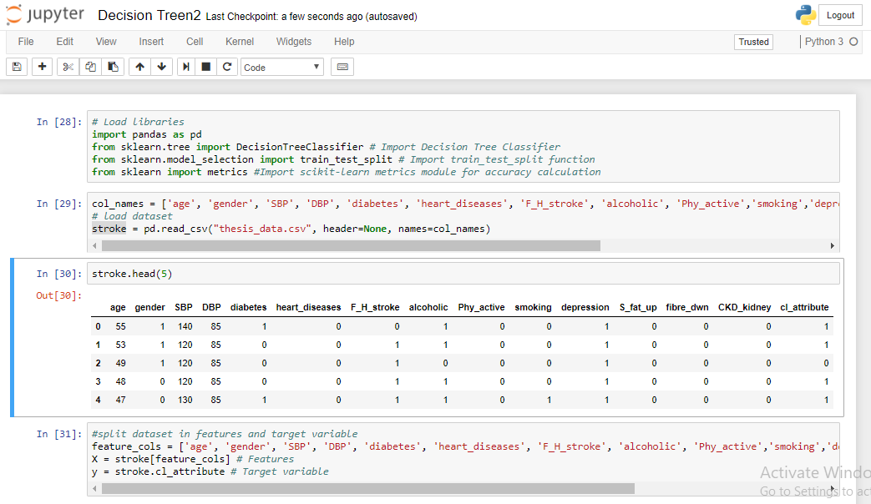
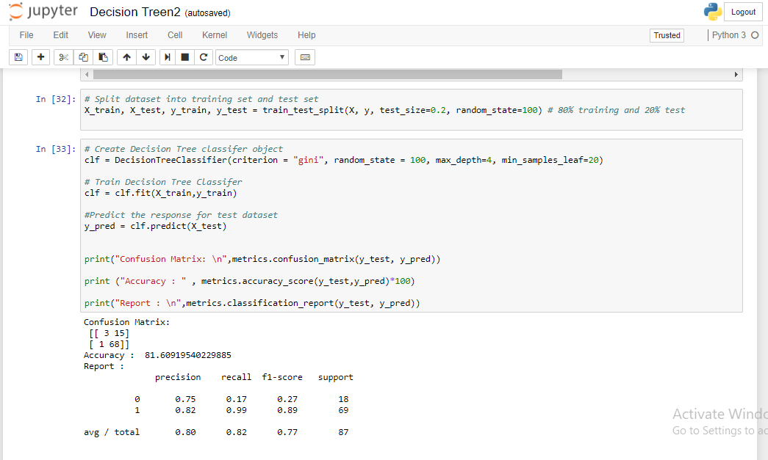
Code implement Using Python
Page: 10

Slide 12
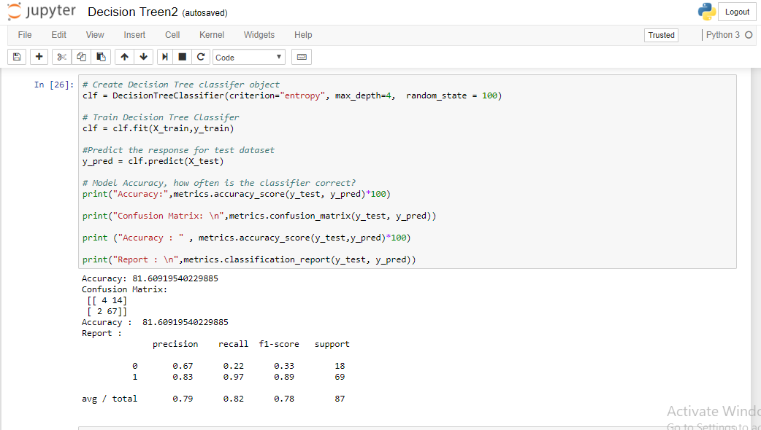
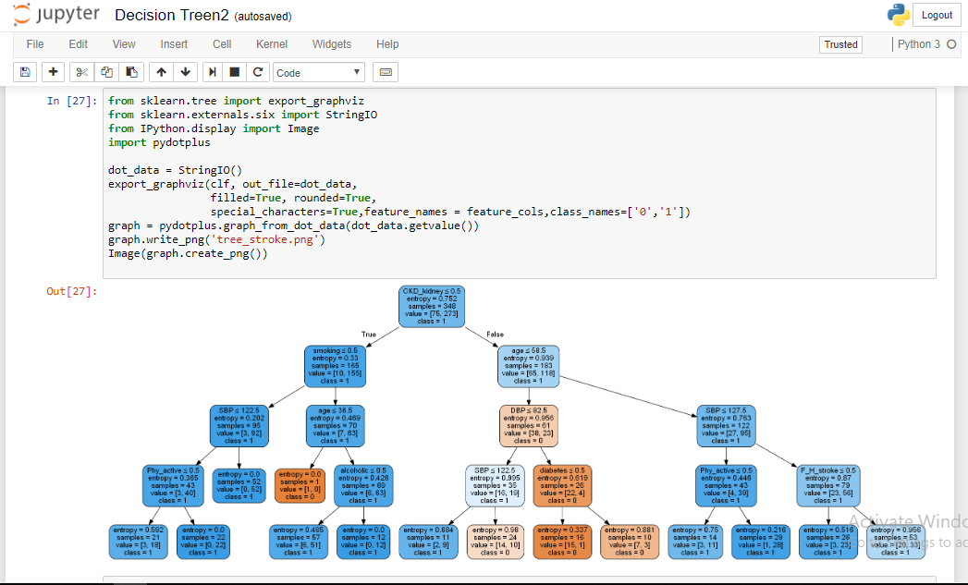
Code implement Using Python
Page: 11

Slide 13
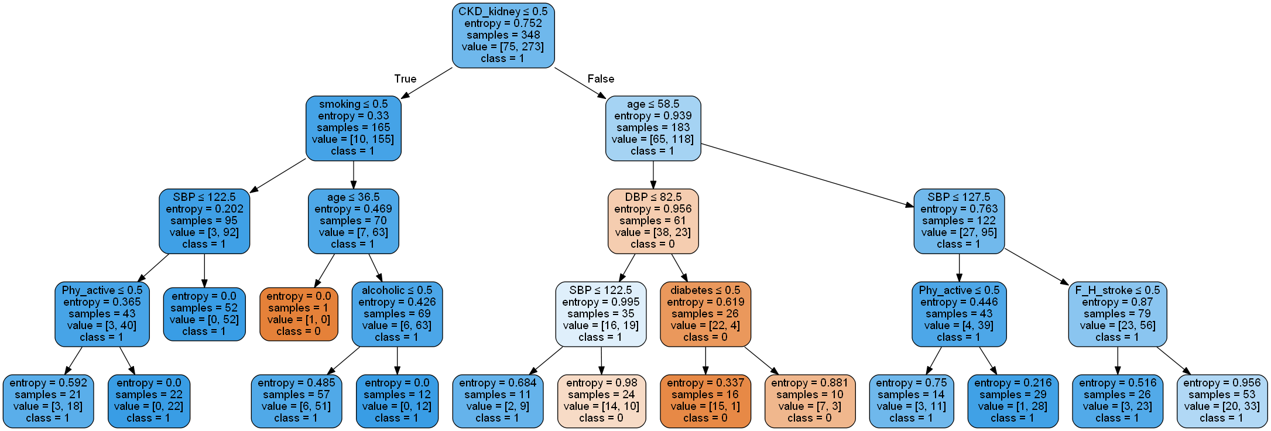
Decision Tree
Page: 12

Slide 14
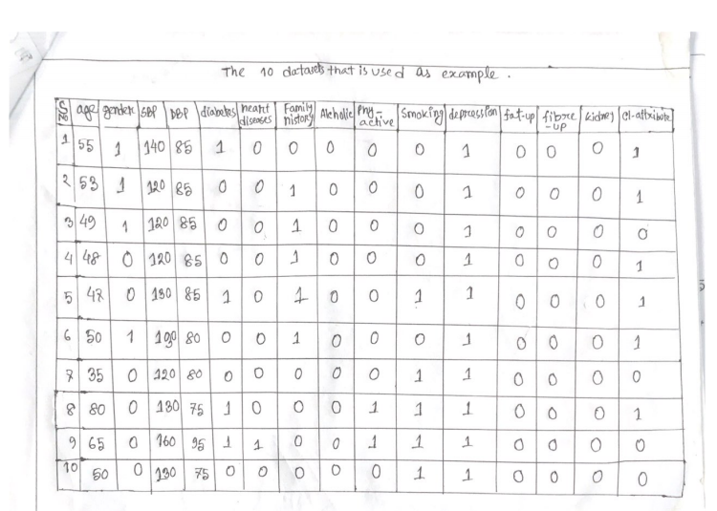
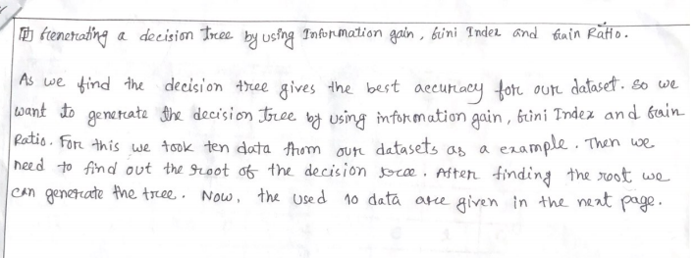
Manual Analysis of the Dataset using 10 samples
Page: 13

Slide 15
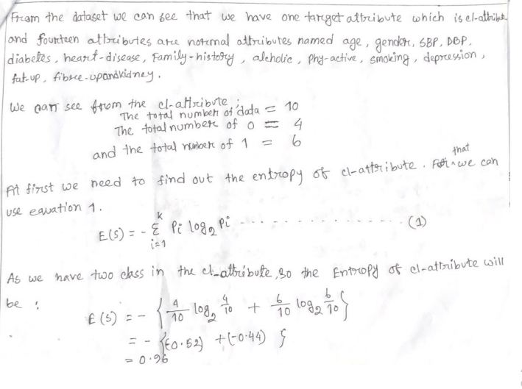
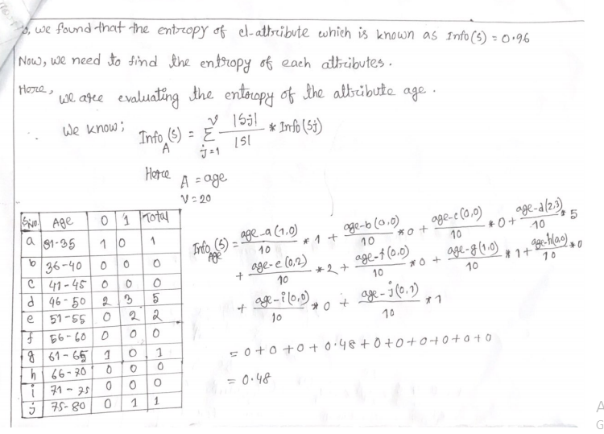
Manual Analysis of the Dataset using 10 samples
Page: 14

Slide 16
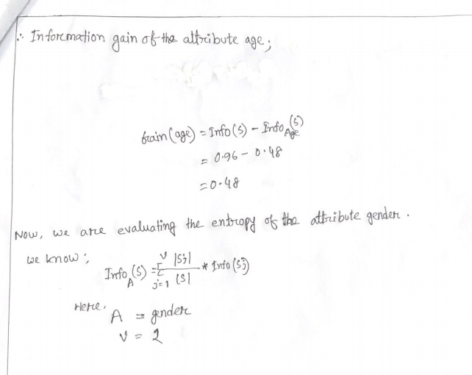
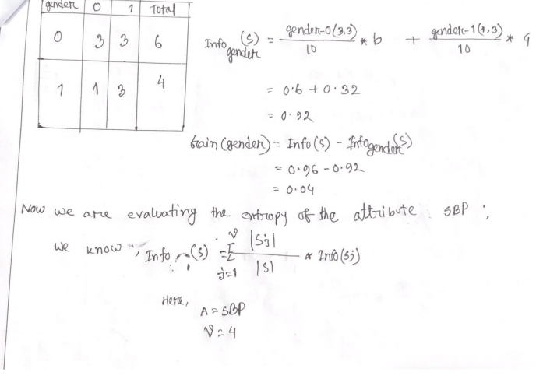
Manual Analysis of the Dataset using 10 samples
Page: 15

Slide 17
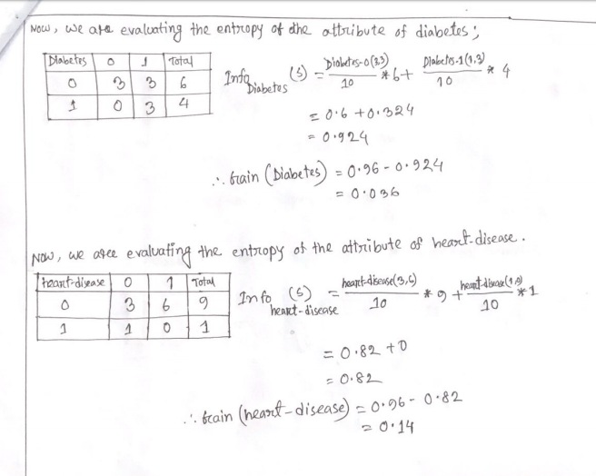
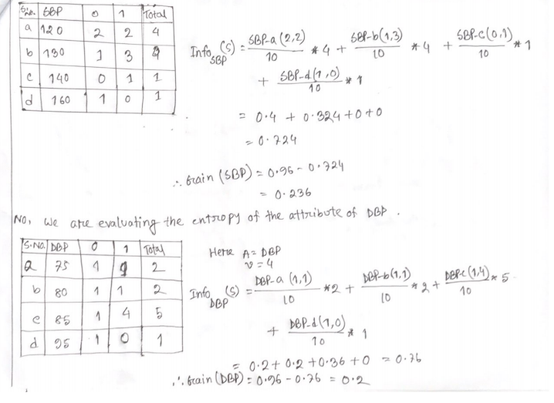
Manual Analysis of the Dataset using 10 samples
Page: 16

Slide 18
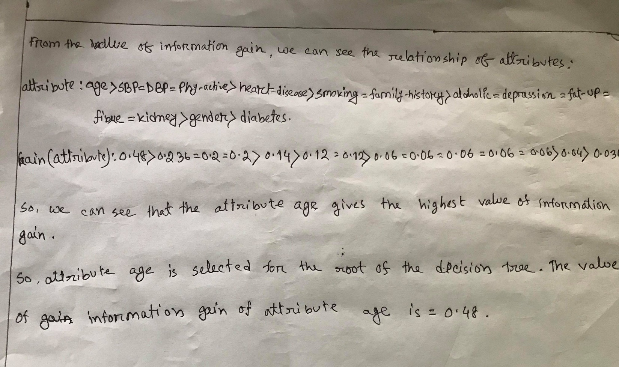
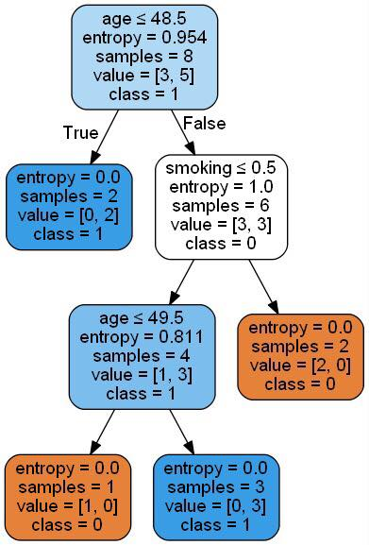
Manual Analysis of the Dataset using 10 samples
Page: 17

Slide 19
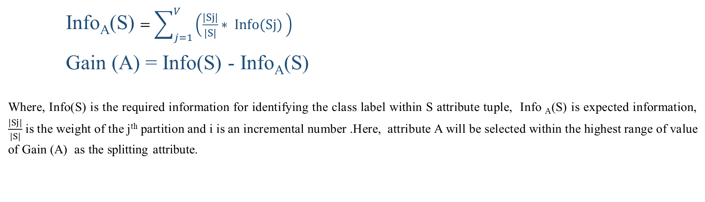
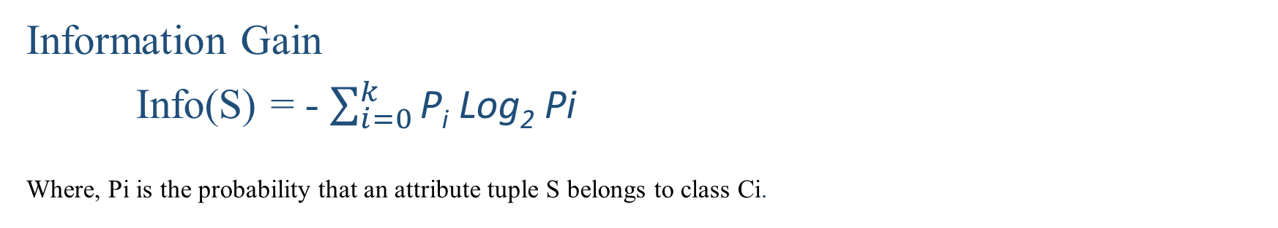
Used Equations for Decision Tree
Page: 18
Information Gain
Info(S) = - $\sum_{i=0}^{k}{\text{P}\text{i} \text{Log}\text{2} \text{Pi} }$
Where, Pi is the probability that an attribute tuple S belongs to class Ci.
Info_{A}(S)$=\sum_{j=1}^{V}{\left(\frac{|Sj|}{|S|}∗ Info(Sj) \right)}$
Gain (A) = Info(S) - Info_{A}(S)
Where, Info(S) is the required information for identifying the class label within S attribute tuple, Info _{A}(S) is expected information, $\frac{|Sj|}{|S|}$ is the weight of the j^{th} partition and i is an incremental number .Here, attribute A will be selected within the highest range of value of Gain (A) as the splitting attribute.

Slide 20
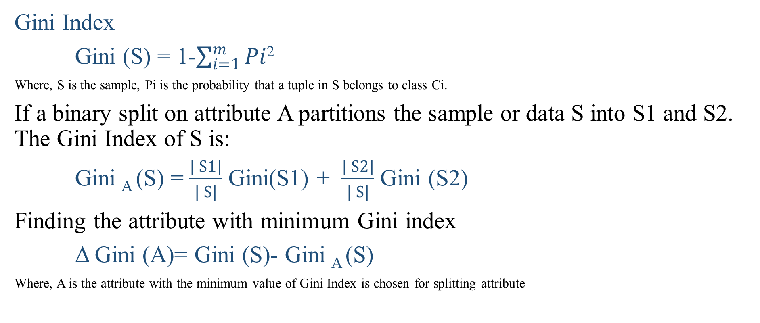
Used Equations for Decision Tree
Page: 19
Gini Index
Gini (S) = 1-$\sum_{i=1}^{m}{Pi}$²
Where, S is the sample, Pi is the probability that a tuple in S belongs to class Ci.
If a binary split on attribute A partitions the sample or data S into S1 and S2. The Gini Index of S is:
Gini _{A} (S) = $\frac{| S1|}{| S|}$ Gini(S1) + $\frac{| S2|}{| S|}$Gini (S2)
Finding the attribute with minimum Gini index
Δ Gini (A)= Gini (S)- Gini _{A} (S)
Where, A is the attribute with the minimum value of Gini Index is chosen for splitting attribute

Slide 21
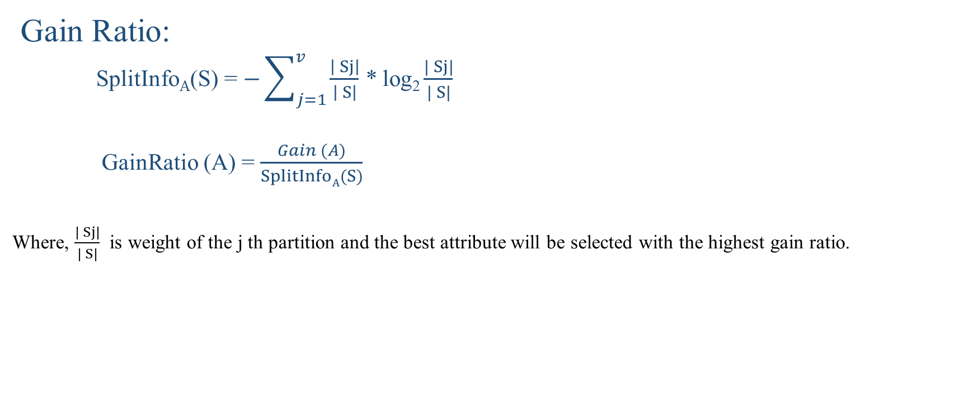
Used Equations for Decision Tree
Page: 20
Gain Ratio:
SplitInfo_{A}(S) =$−\sum_{j=1}^{v}{\frac{\left| Sj\right|}{\left| S\right|}}$ * log₂ $\frac{| Sj|}{| S|}$
GainRatio(A) = $\frac{Gain (A)}{SplitInfoA(S)}$
Where, $\frac{| Sj|}{| S|}$ is weight of the j thpartition and the best attribute will be selected with the highest gain ratio.

Slide 22
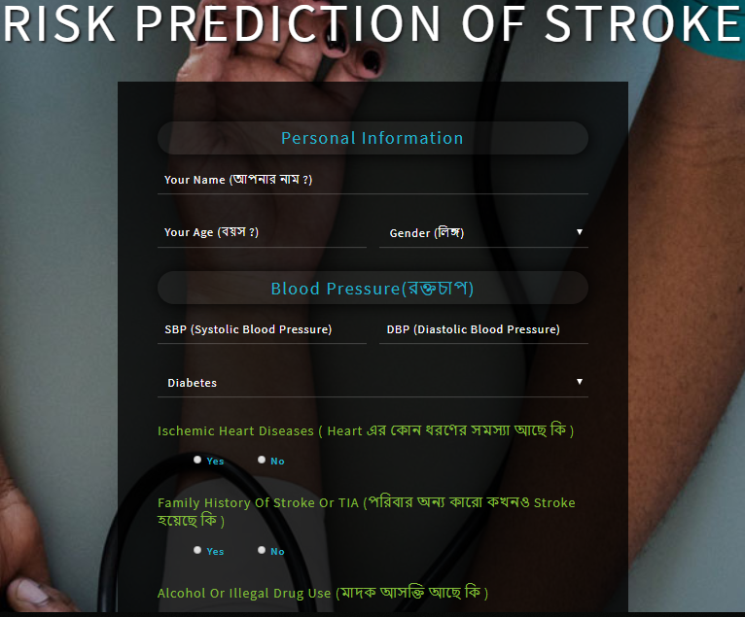
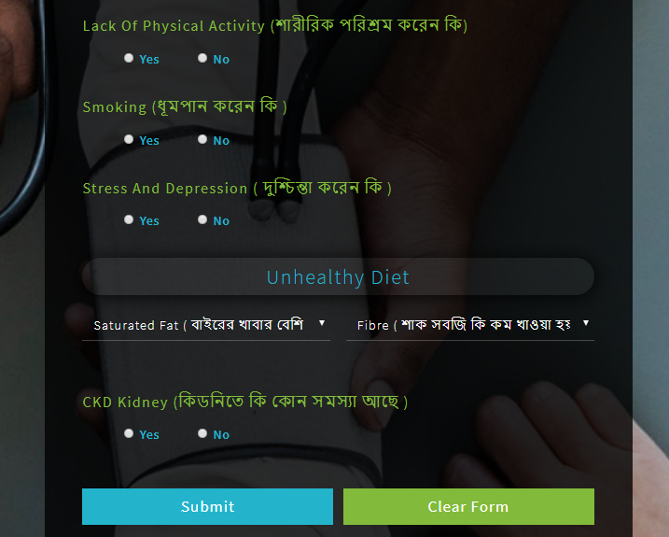
Proposed Tool
Page: 21

Slide 23
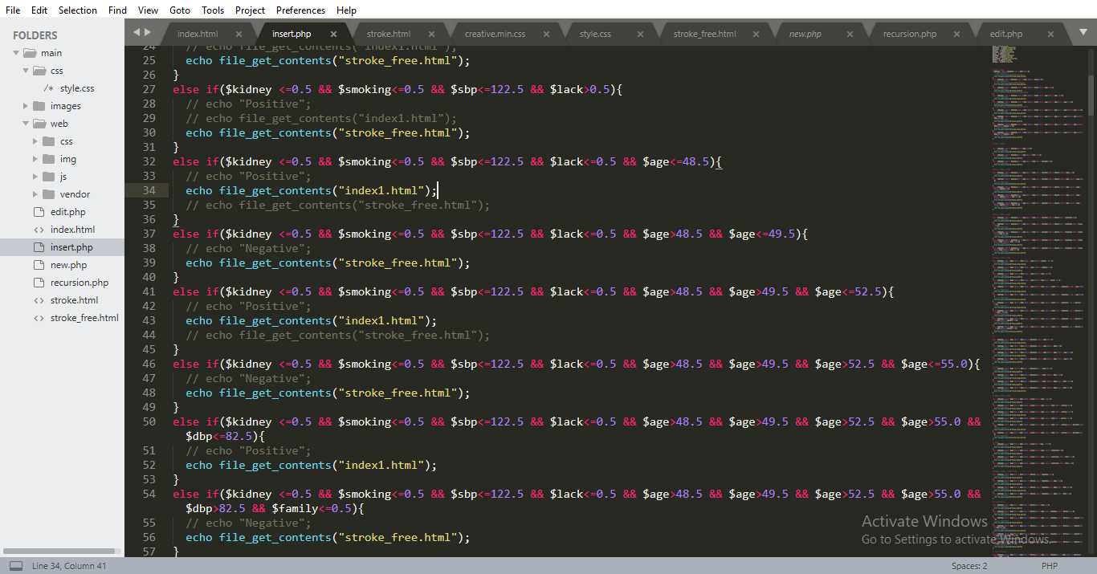
Logical Conditions
Page: 22

Slide 24
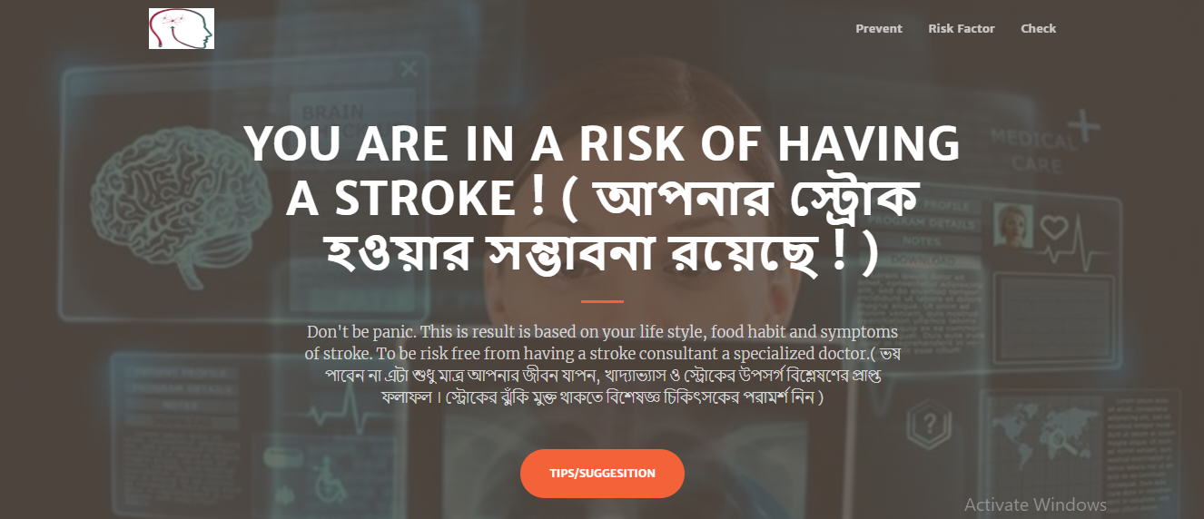
Demo of predicted result Stroke
Page: 23

Slide 25
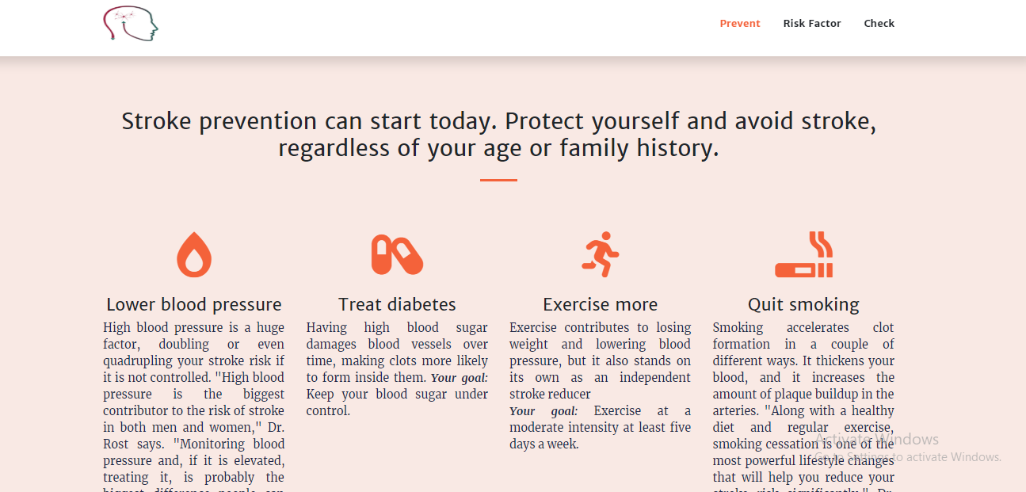
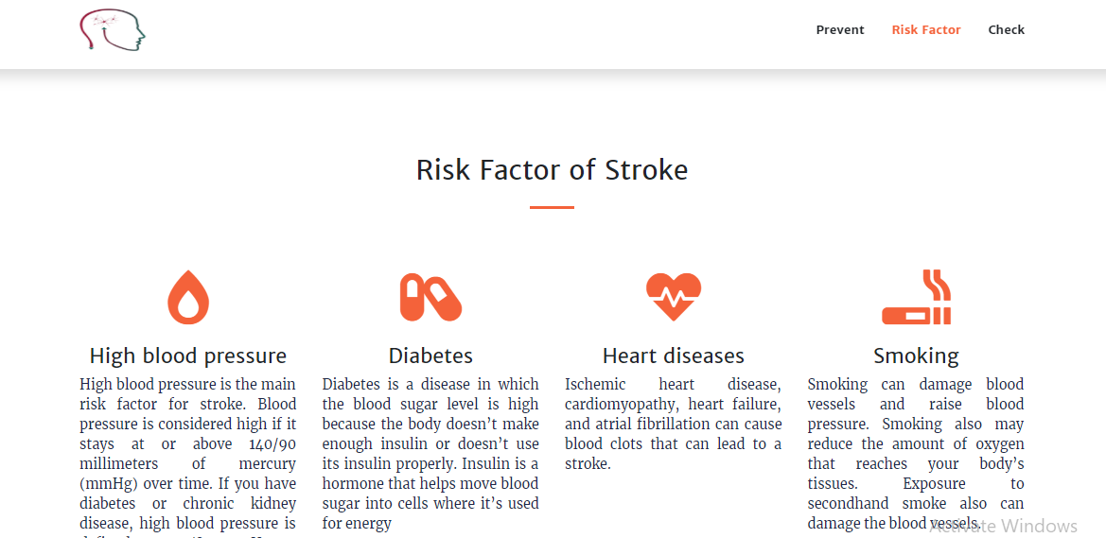
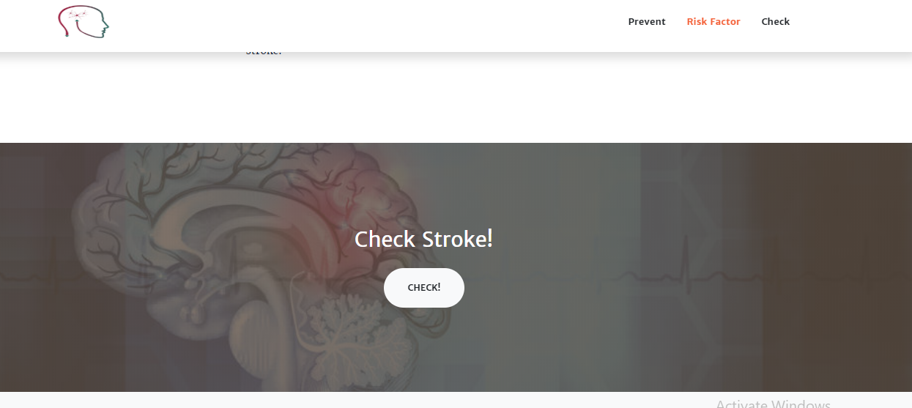
Demo of predicted result Stroke
Page: 24

Slide 26

Demo of predicted result Non-stroke
Page: 25

Slide 27
Challenges
Page: 26
Data Collecting
Communicate with the Patient and Doctor
Understanding medical terms
Simplifying the questionnaire form

Slide 28
Limitation
Page: 27
Data Collected only from the few hospitals in Sylhet.
System is not deployed.

Slide 29
Conclusion & Future Scope
Page: 28
Conclusion:
1. A proper analysis of the relevant dataset to obtain the prediction method of best accuracy a reliable prediction tool is required.
Future scope:
1. Deploying a website or mobile apps developed using Decision Tree method for mass people can be considered as the future scope of this work.
2. Regularly updated data from the user in the system will enrich the dataset.
3. Analysis of real system performance can also be conducted.

Slide 30
References
Page: 29
[1] National Heart, L. a. B. I., n.d. National Heart, Lung, and Blood Institute. [Online]
Available at: http://www.nhibi.nih.gov/health-topics/stroke
[Accessed 3 January 2019].
[2] National Heart, L. a. B. I., n.d. National Heart, Lung, and Blood Institute. [Online]
Available at: http://www.nhibi.nih.gov/health-topics/stroke
[Accessed 3 January 2019].
[3] National Heart, L. a. B. I., n.d. National Heart, Lung, and Blood Institute. [Online]
Available at: http://www.nhibi.nih.gov/health-topics/stroke
[Accessed 3 January 2019].

Slide 31

Page: 30
Thank You !

Slide 32
Page: 31
Any Query ?

